Slide 1

INTERNET
OF
THINGS

Slide 2
INTERNET
OF
THINGS

Slide 3
Internet is a vast network that connects computers all over the world.
The word internet comes from combination between "interconnection" and "network"
INTERNET
OF
THINGS

Slide 4

a material thing that can be seen and touched.
INTERNET
OF
THINGS

Slide 5
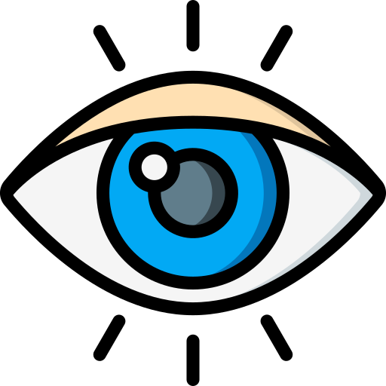
a material thing that can be seen and touched.
INTERNET
OF
THINGS

Slide 6
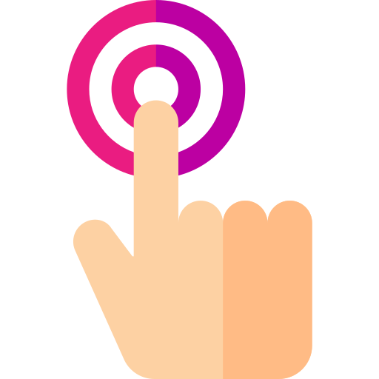
a material thing that can be seen and touched.
INTERNET
OF
THINGS

Slide 7
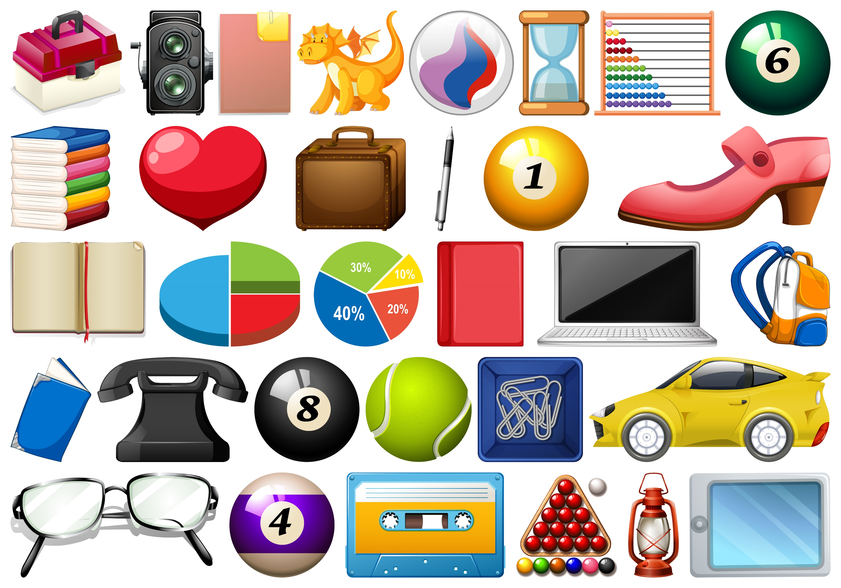
a material thing that can be seen and touched.
INTERNET
OF
THINGS

Slide 8
THINGS = DEVICE
INTERNET
OF
THINGS

Slide 9
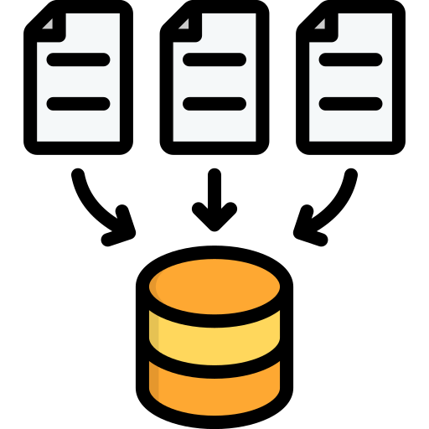


Characteristics of Devices
THINGS + DEVICE = IOT

Slide 10
Characteristics of Devices
Data Acquisition
the process of converting real-world signals to the digital values
THINGS + DEVICE = IOT

Slide 11
Characteristics of Devices
Data Processing
THINGS + DEVICE = IOT
Data processing occurs when data is collected and translated into usable information

Slide 12
Characteristics of Devices
THINGS + DEVICE = IOT
Display or Action
The process of doing something to make something happen or to deal with a situation

Slide 13

INTERNET OF PEOPLE

Slide 14

INTERNET OF PEOPLE
DIRECT CONVERSATION

Slide 15

INTERNET OF PEOPLE
DIRECT CONVERSATION
WIRED/
LANDLINE

Slide 16
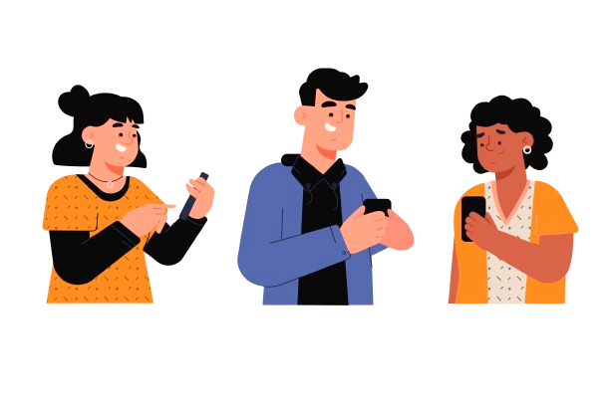
INTERNET OF PEOPLE
DIRECT CONVERSATION
WIRED/
LANDLINE
WIRELESS
COMMUNICATION

Slide 17
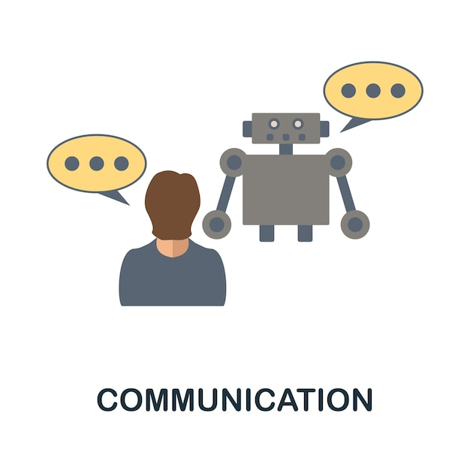
INTERNET OF THINGS
Human
Machine Communication

Slide 18
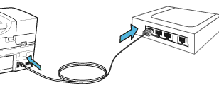
INTERNET OF THINGS
Human
Machine Communication
WIRED Machine
To Machine

Slide 19
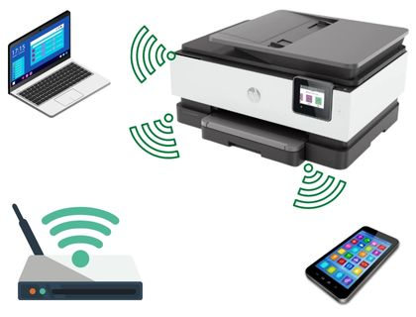
INTERNET OF THINGS
Human
Machine Communication
WIRED Machine
To Machine
WIRELESS
COMMUNICATION

Slide 20
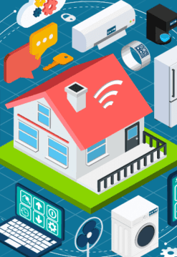
What is IoT ?
INTERNET OF THINGS
IoT is a system of devices Connected to the Internet with the ability to
collects and exchange data from users or environment
with no Human intervention

Slide 21

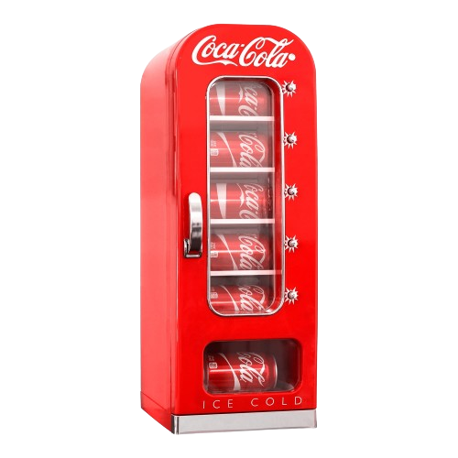
Who invented IoT ?
Kevin Ashton is an innovator and consumer sensor expert who coined the phrase “the Internet of Things” to describe the network connecting objects in the physical world to the Internet.
IOT VENDING MACHINE

Slide 22
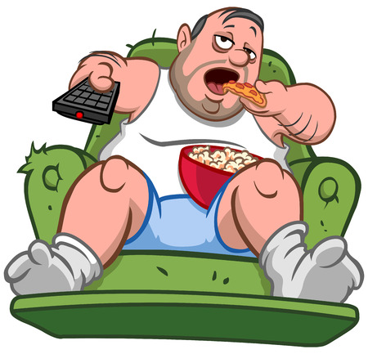
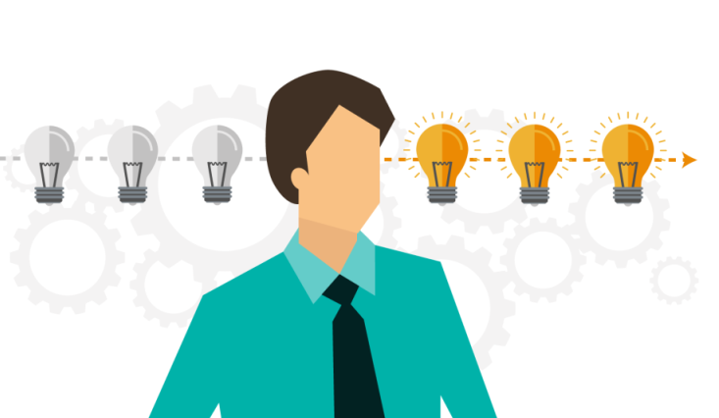
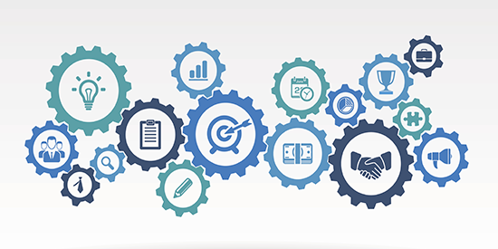
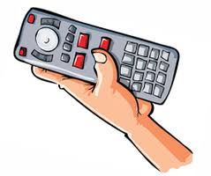
Why IoT ?
We are lazy
To get Realtime Data
To make automate Everything
To control everything remotely

Slide 23
IoT Lifecycle
Sending Data and events
through network
to some destination
Taking action based on
information and data
Collection
Communication
Analyze
Action
Devices & Sensors
Collects Data
everywhere
Creating Information
from the Data

Slide 24
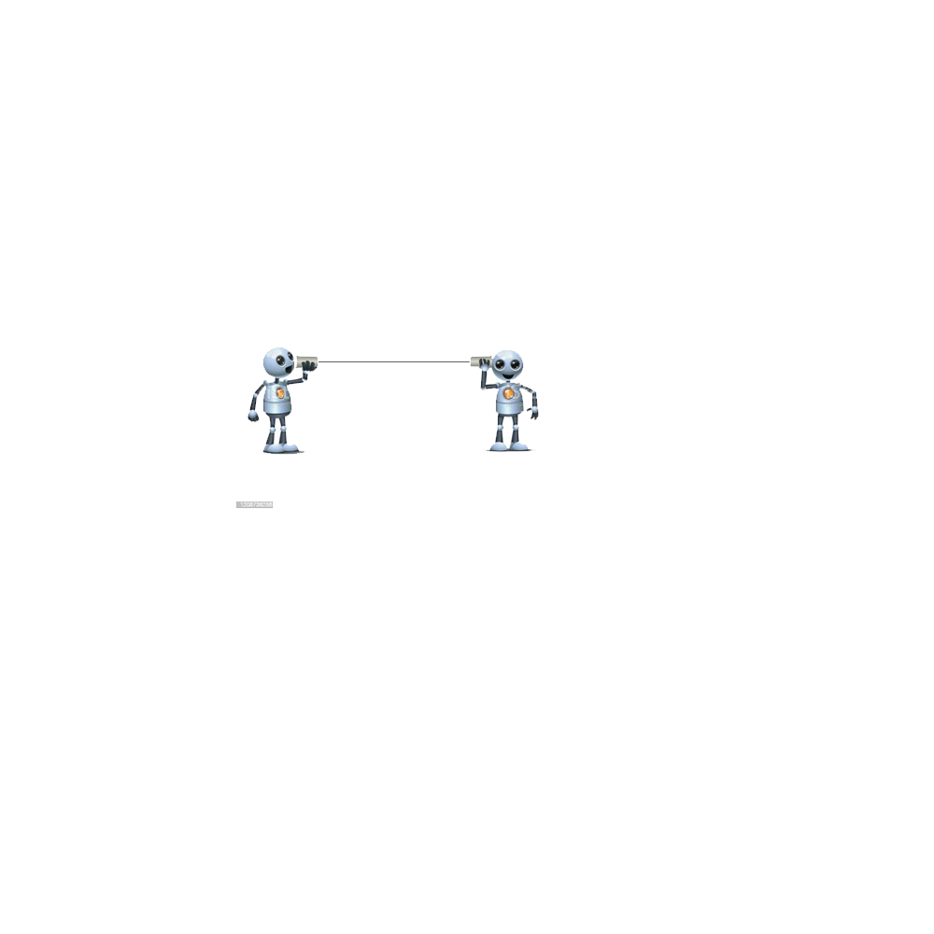
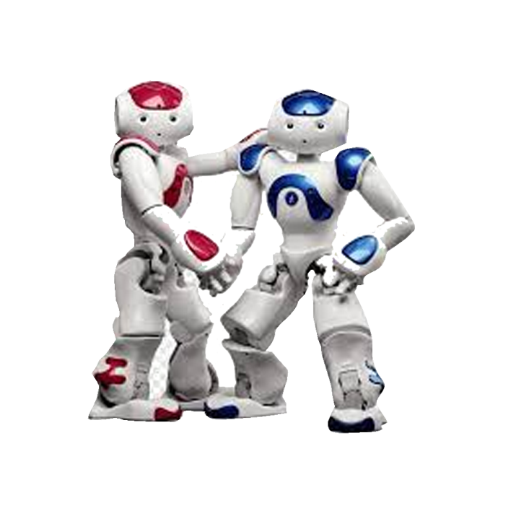
IoT
Communication between
Machines with
Network/Internet
Communication between
Machines without
Network/Internet
Embedded

Slide 25
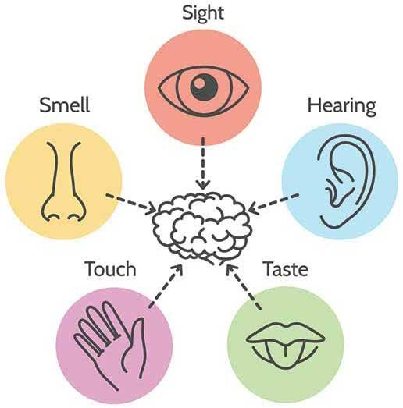
Human
Sensors

Slide 26
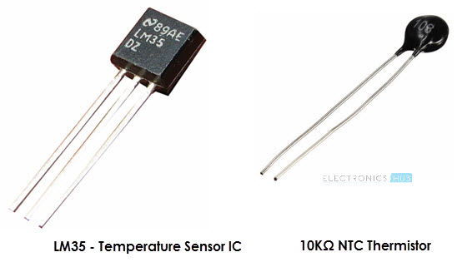
Temperature Sensor One of the most common and most popular sensors is the Temperature Sensor. A Temperature Sensor, as the name suggests, senses the temperature i.e., it measures the changes in the temperature.
Temperature Sensors are used everywhere like computers, mobile phones, automobiles, air conditioning systems, industries etc.

Slide 27
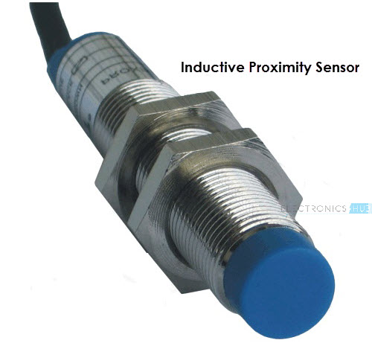
Proximity Sensors A Proximity Sensor is a non-contact type sensor that detects the presence of an object. Proximity Sensors can be implemented using different techniques like Optical (like Infrared or Laser), Sound (Ultrasonic), Magnetic (Hall Effect), Capacitive, etc.
Some of the applications of Proximity Sensors are Mobile Phones, Cars (Parking Sensors), industries Proximity in Aircrafts, etc.

Slide 28
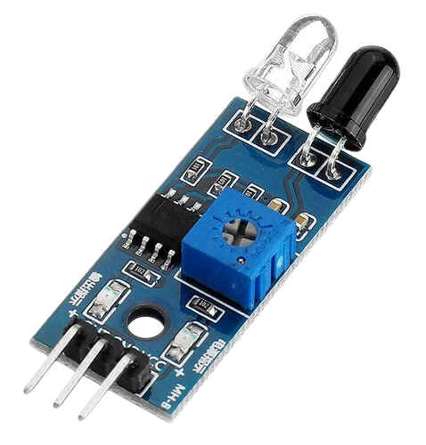
Infrared Sensor (IR Sensor) IR Sensors or Infrared Sensor are light based sensor that are used in various applications like Proximity and Object Detection. IR Sensors are used as proximity sensors in almost all mobile phones.
A small project, where IR Sensors are used to turn on street lights: STREET LIGHTS USING IR SENSORS.

Slide 29
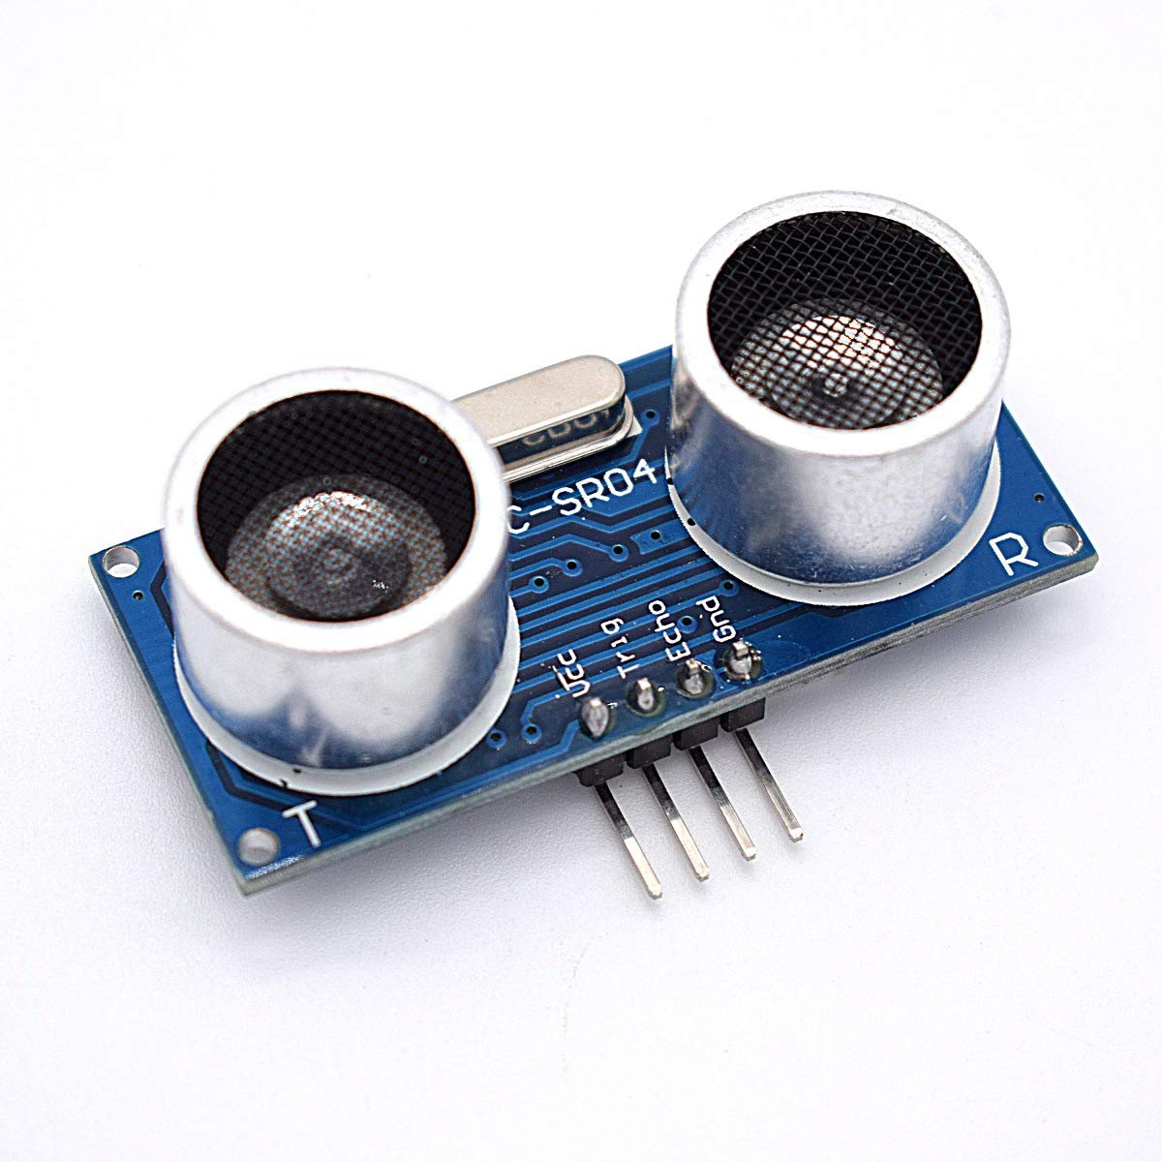
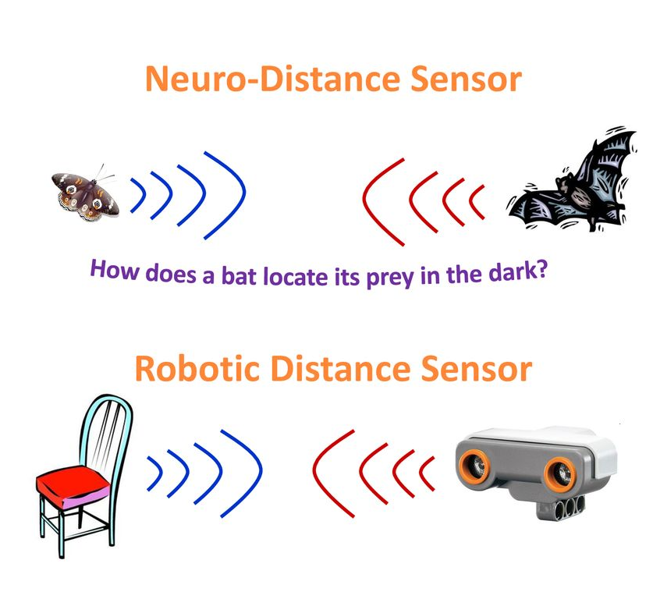
Ultrasonic Sensor An Ultrasonic Sensor is a non-contact type device that can be used to measure distance as well as velocity of an object. An Ultrasonic Sensor works based on the properties of the sound waves with frequency greater than that of the human audible range.

Slide 30
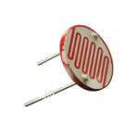
Light Sensor (LDR) Sometimes also known as Photo Sensors, Light Sensors are one of the important sensors. A simple Light Sensor available today is the Light Dependent Resistor or LDR. The property of LDR is that its resistance is inversely proportional to the intensity of the ambient light i.e., when the intensity of light increases, its resistance decreases and vise-versa. By using LDR is a circuit, we can calibrate the changes in its resistance to measure the intensity of Light.

Slide 31
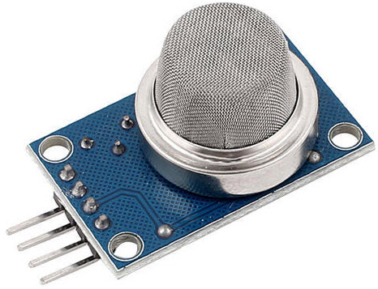
Smoke and Gas Sensors One of the very useful sensors in safety related applications are Smoke and Gas Sensors. Almost all offices and industries are equipped with several smoke detectors, which detect any smoke (due to fire) and sound an alarm
Check out this SMOKE DETECTOR ALARM CIRCUIT without using Arduino

Slide 32
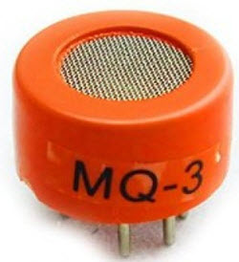
Alcohol Sensor As the name suggests, an Alcohol Sensor detects alcohol. Usually, alcohol sensors are used in breathalyzer devices, which determine whether a person is drunk or not. Law enforcement personnel uses breathalyzers to catch drunk-and-drive culprits.

Slide 33
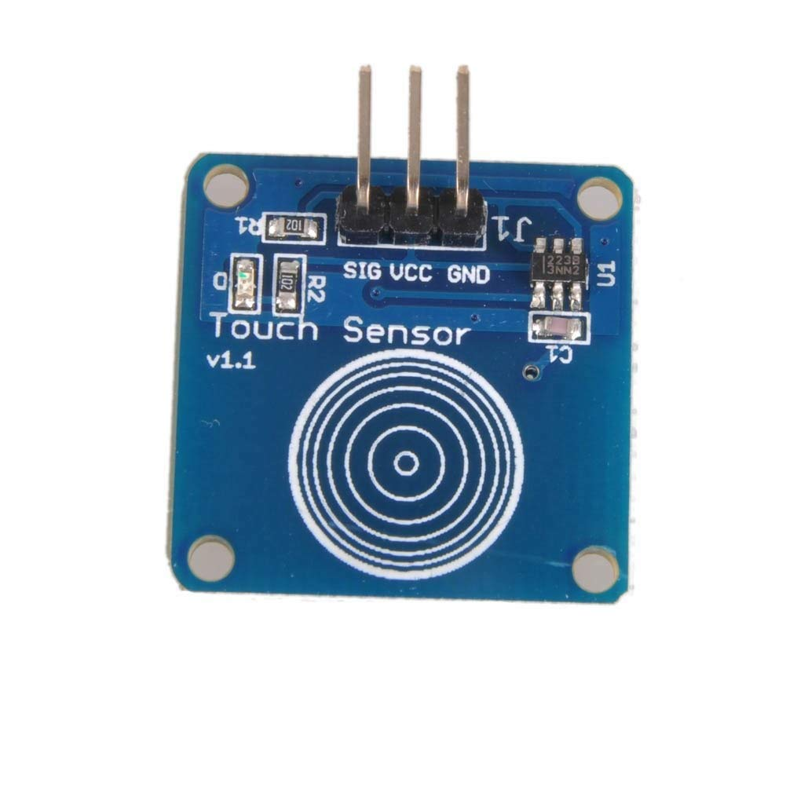
Touch Sensor
A touch sensor is a type of device that captures and records physical touch or embrace on a device and/or object. It enables a device or object to detect touch or near proximity, typically by a human user or operator

Slide 34
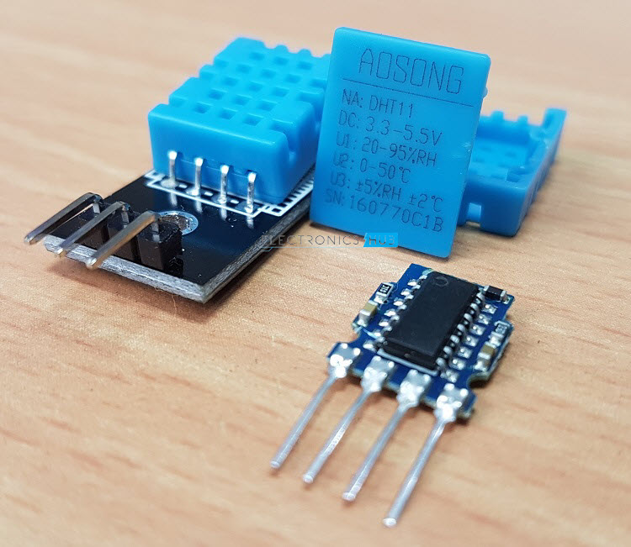
Humidity Sensor If you see Weather Monitoring Systems, they often provide temperature as well as humidity data. So, measuring humidity is an important task in many applications and Humidity Sensors help us in achieving this.

Slide 35
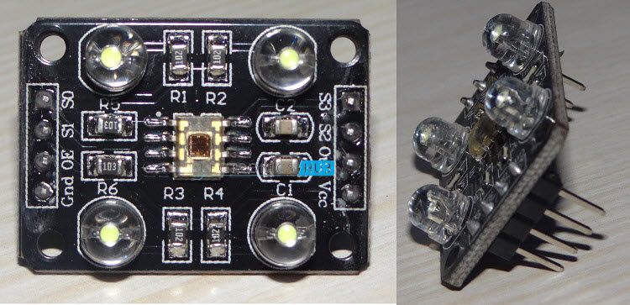
Color Sensor A Color Sensor is an useful device in building color sensing applications in the field of image processing, color identification, industrial object tracking etc. The TCS3200 is a simple Color Sensor, which can detect any color and output a square wave proportional to the wavelength of the detected color.

Slide 36
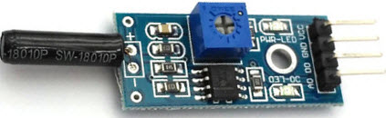
Tilt Sensor Often used to detect inclination or orientation, Tilt Sensors are one of the simplest and inexpensive sensors out there. Previously, tilt sensors are made up of Mercury (and hence they are sometimes called as Mercury Switches) but most modern tilt sensors contain a roller ball.

Slide 37
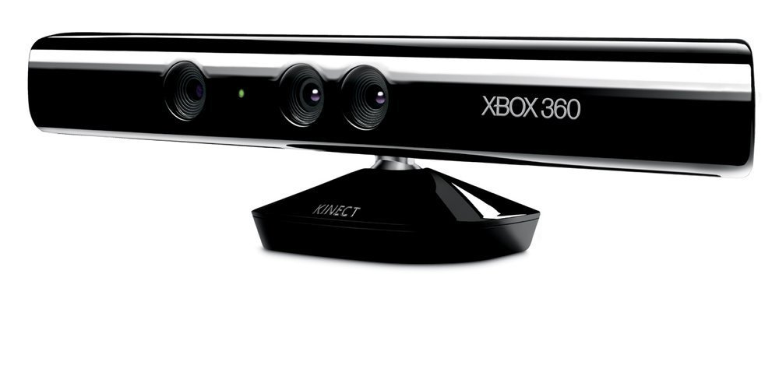
Kinect Sensor
The Kinect sensor is a horizontal bar connected to a small base with a motorized pivot and is designed to be positioned lengthwise above or below the video display

Slide 38
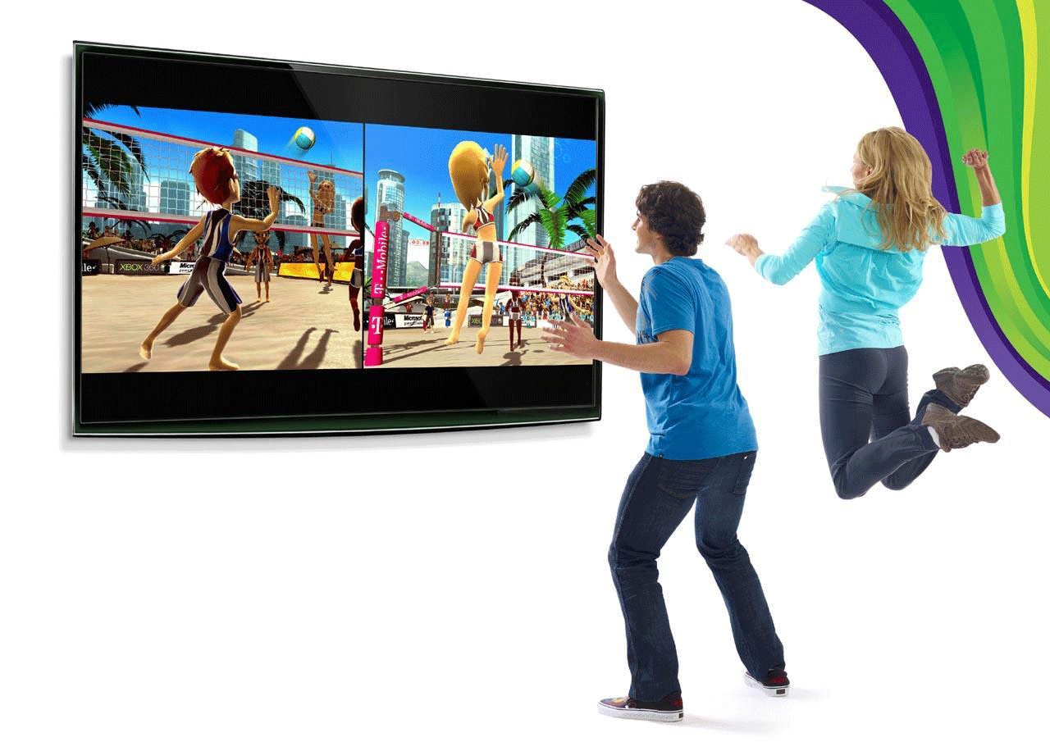

Slide 39
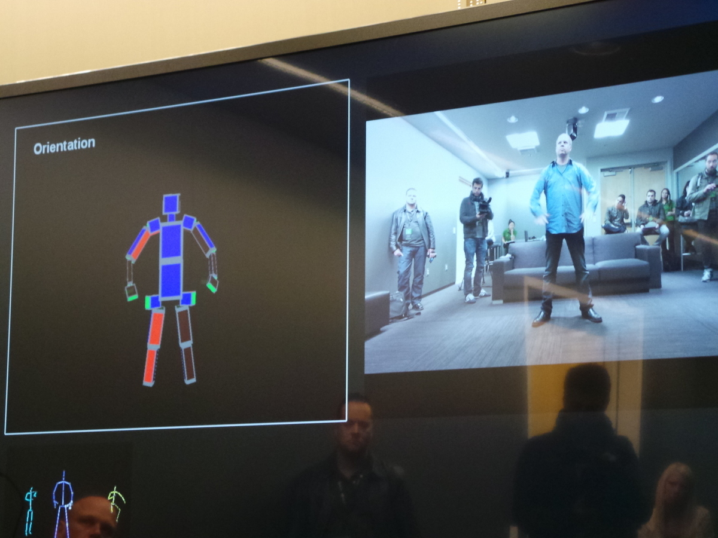
Tilt Sensor Often used to detect inclination or orientation, Tilt Sensors are one of the simplest and inexpensive sensors out there. Previously, tilt sensors are made up of Mercury (and hence they are sometimes called as Mercury Switches) but most modern tilt sensors contain a roller ball.

Slide 40
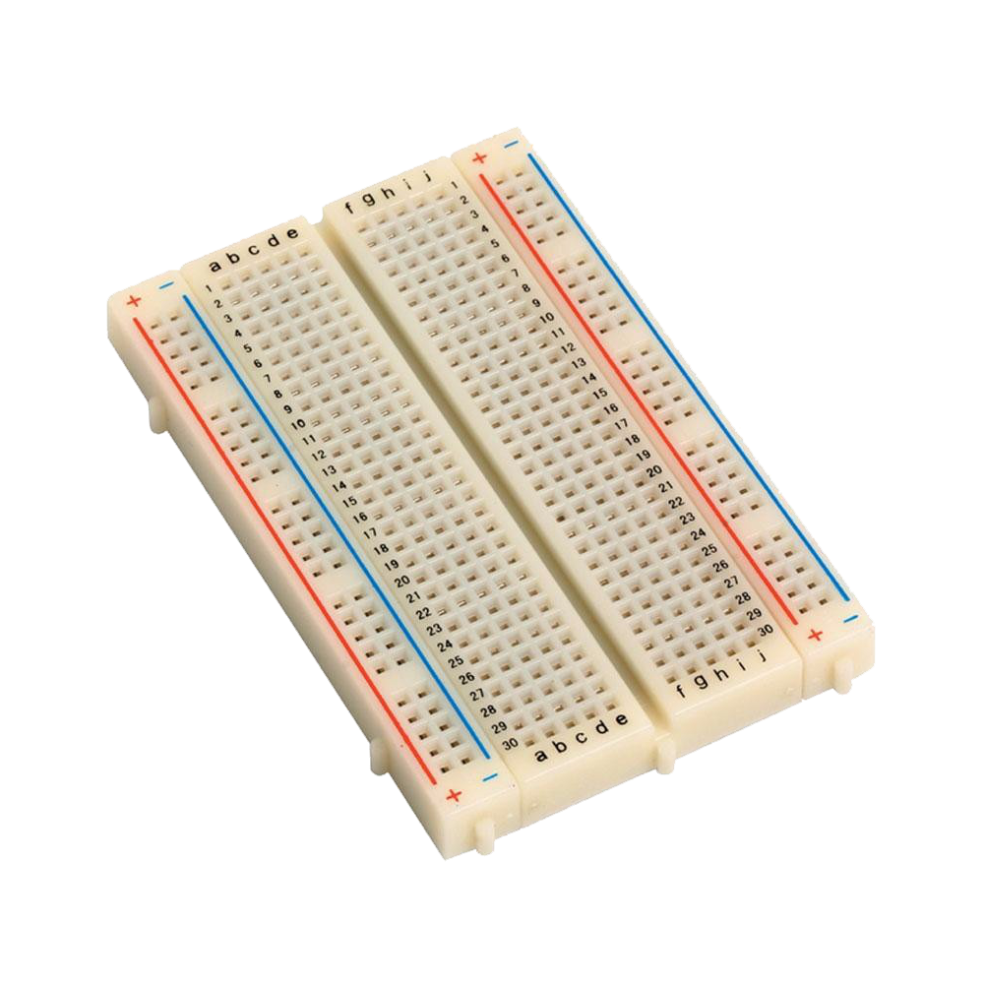
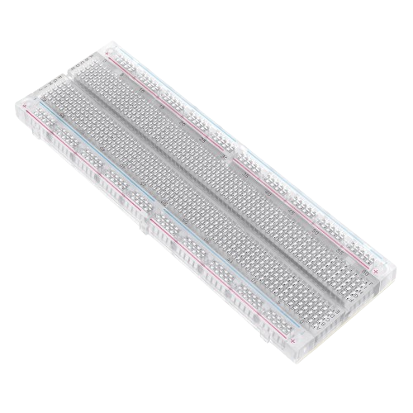
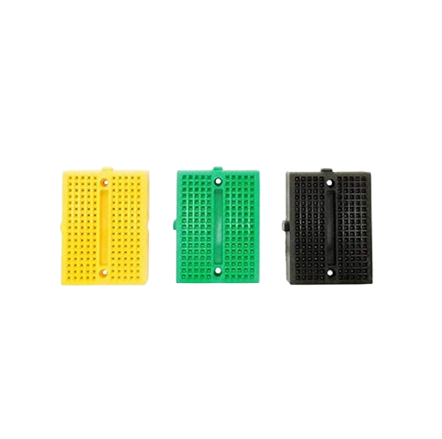
Bread Board
A breadboard is a rectangular board with small holes to insert electronic components. It's a construction base for building semi-permanent prototypes of electronic circuits. Breadboards are also known as protoboards or plug blocks

Slide 41
Bread Board
A breadboard is a rectangular board with small holes to insert electronic components. It's a construction base for building semi-permanent prototypes of electronic circuits. Breadboards are also known as protoboards
or plug blocks

Slide 42
Bread Board
A breadboard is a rectangular board with small holes to insert electronic components. It's a construction base for building semi-permanent prototypes of electronic circuits. Breadboards are also known as protoboards or plug blocks

Slide 43
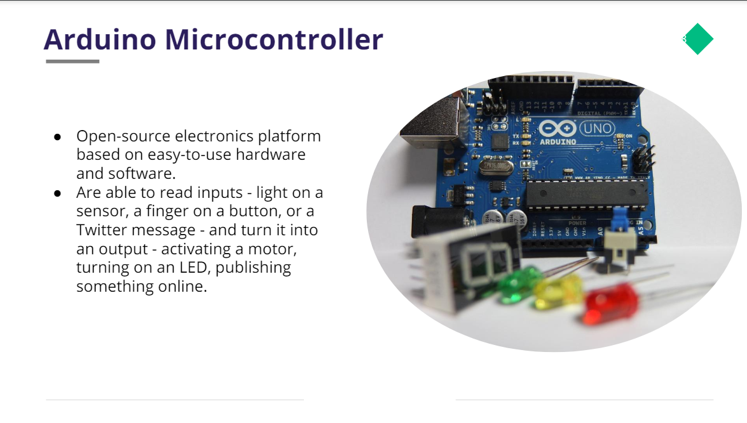

Slide 44
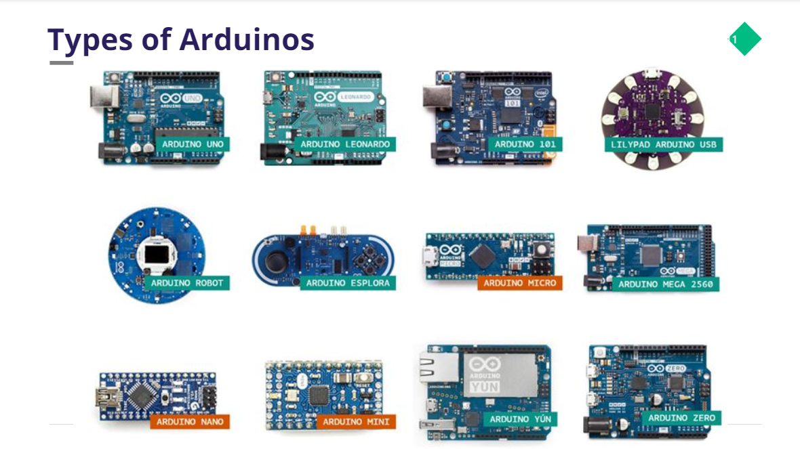

Slide 45
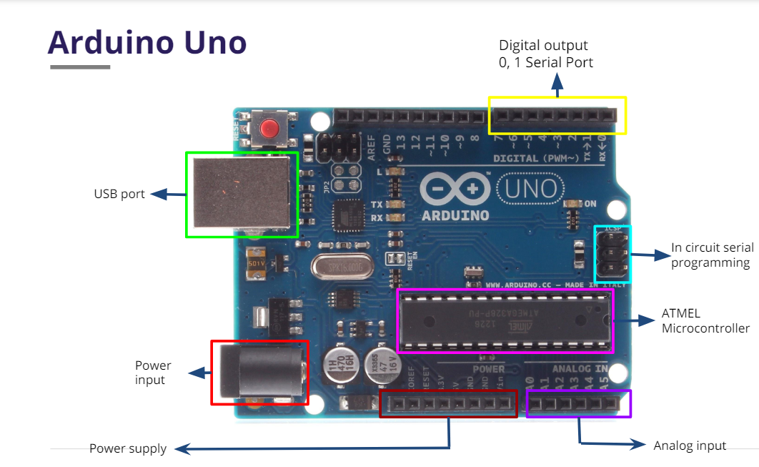

Slide 46


Which software we are using for programming controllers

Slide 47
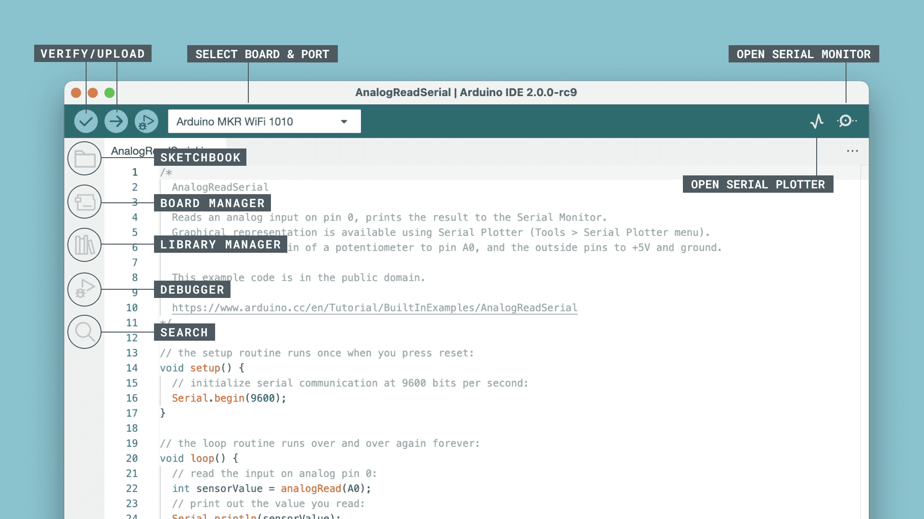

Slide 48


Popular Programming Languages Used
Embedded C
Python

Slide 49
IOT Cloud platforms
Blynk
Arduino cloud
ThingSpeak

Slide 50
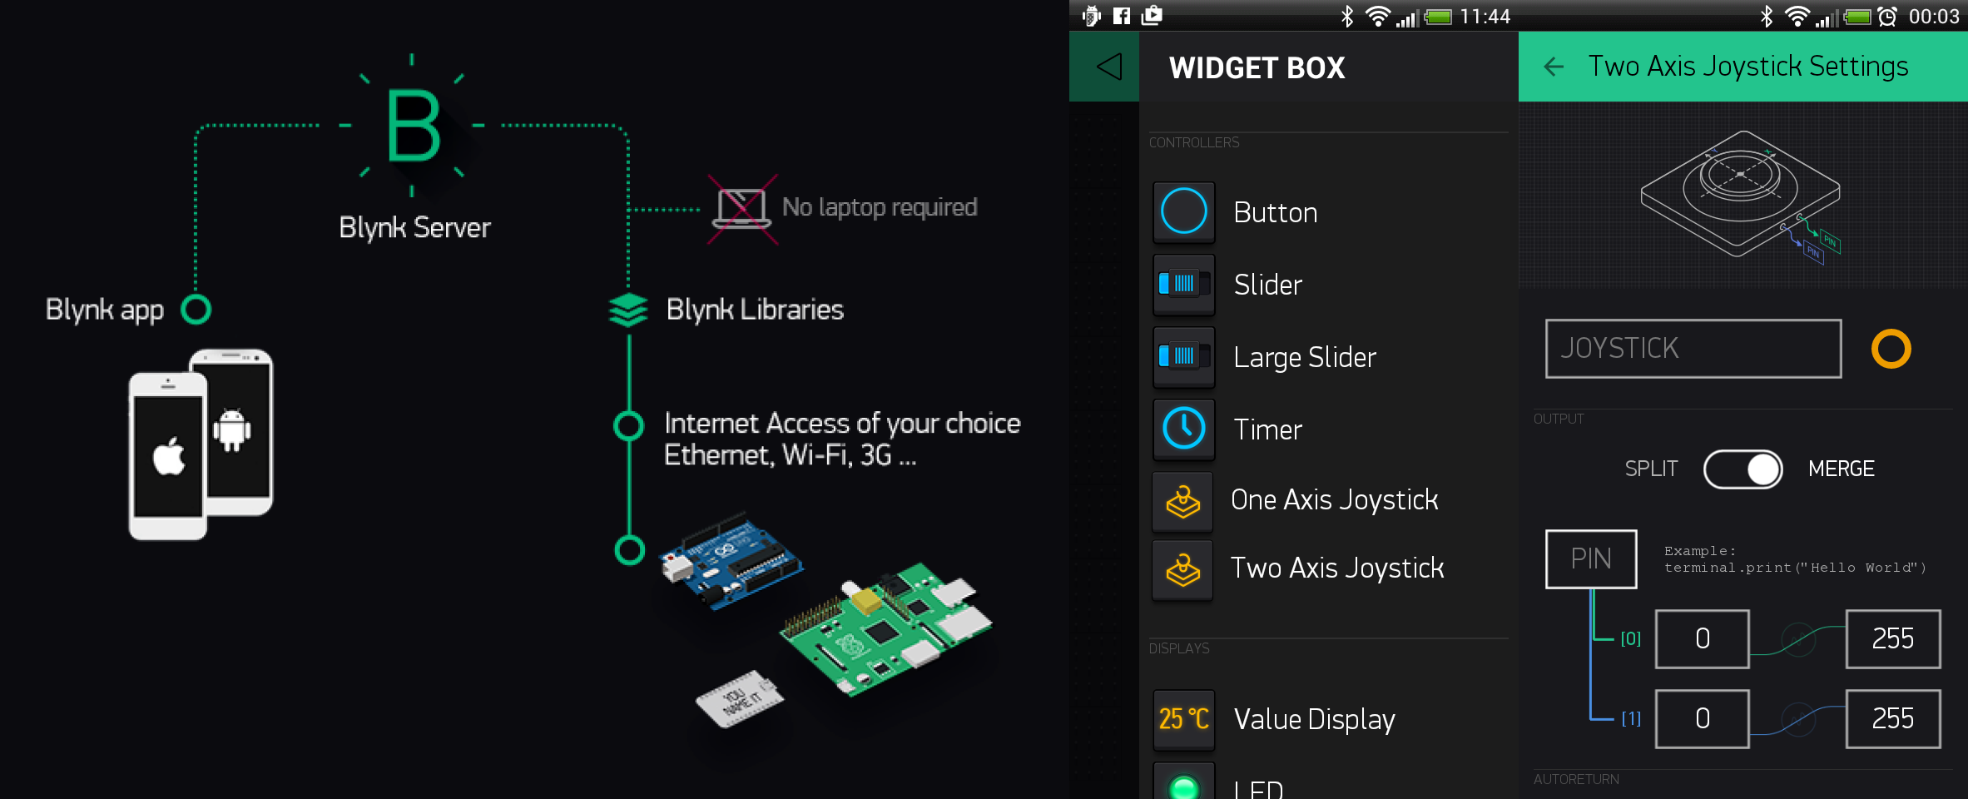
Blynk

Slide 51
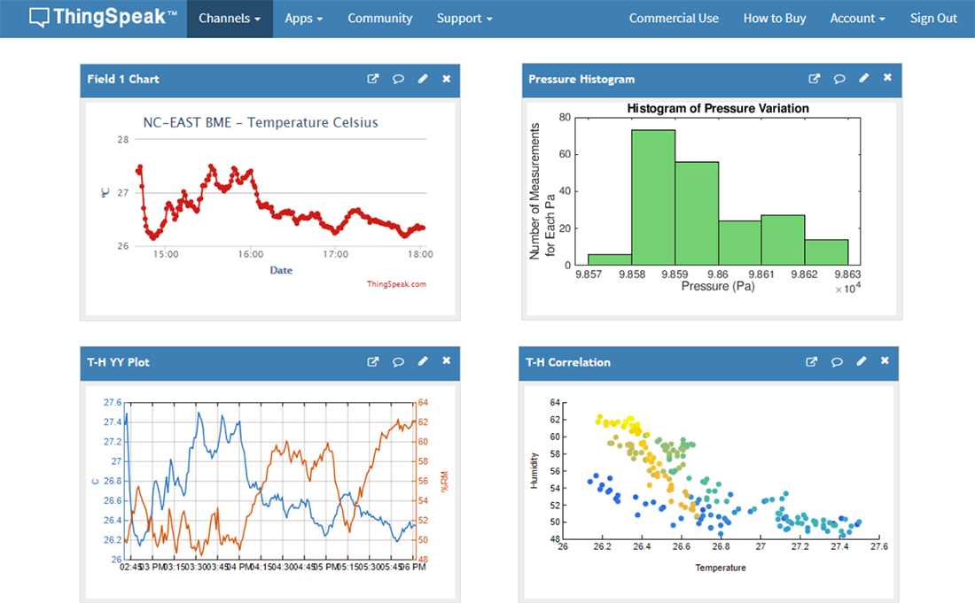
ThingSpeak

Slide 52
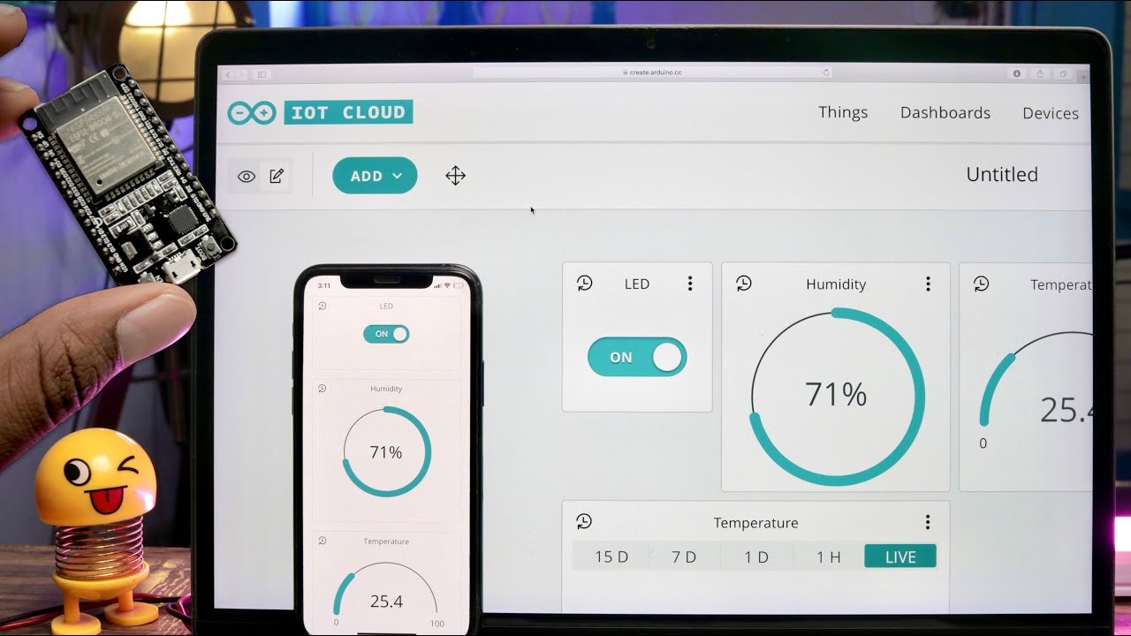
Arduino Cloud

Slide 53


Slide 54
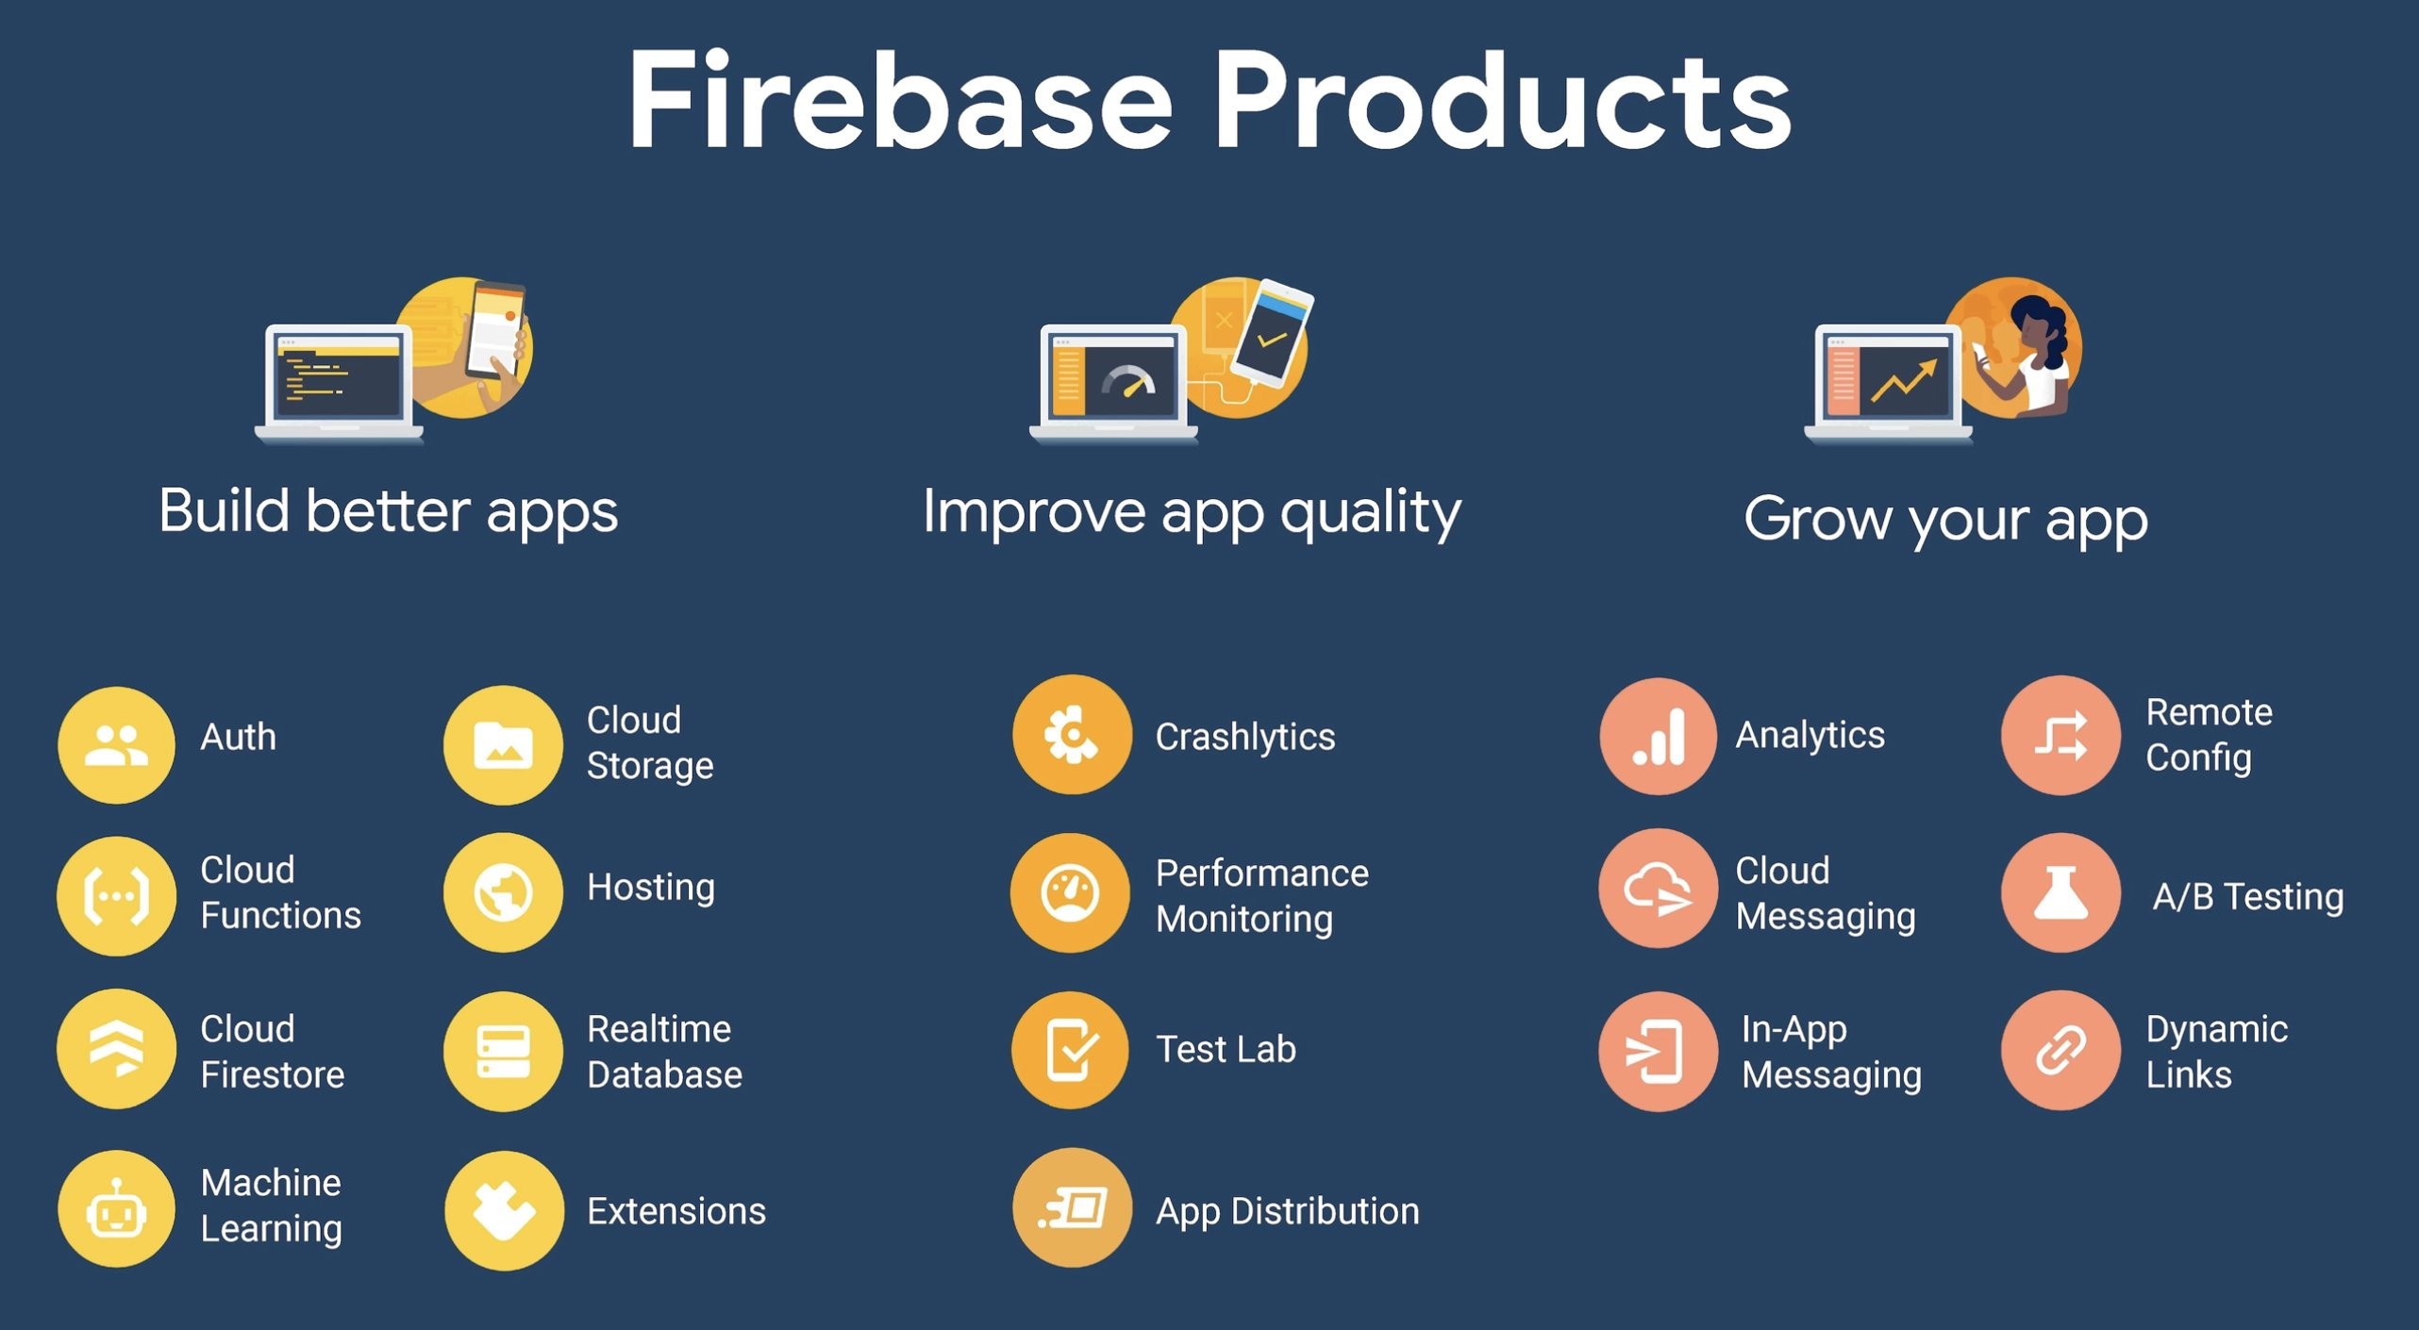

Slide 55
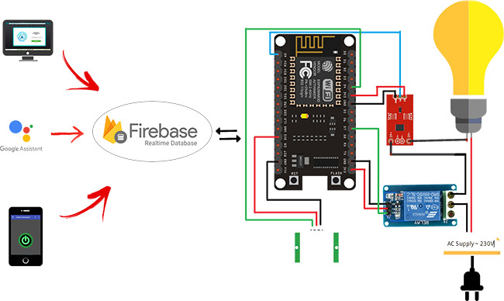

Slide 56
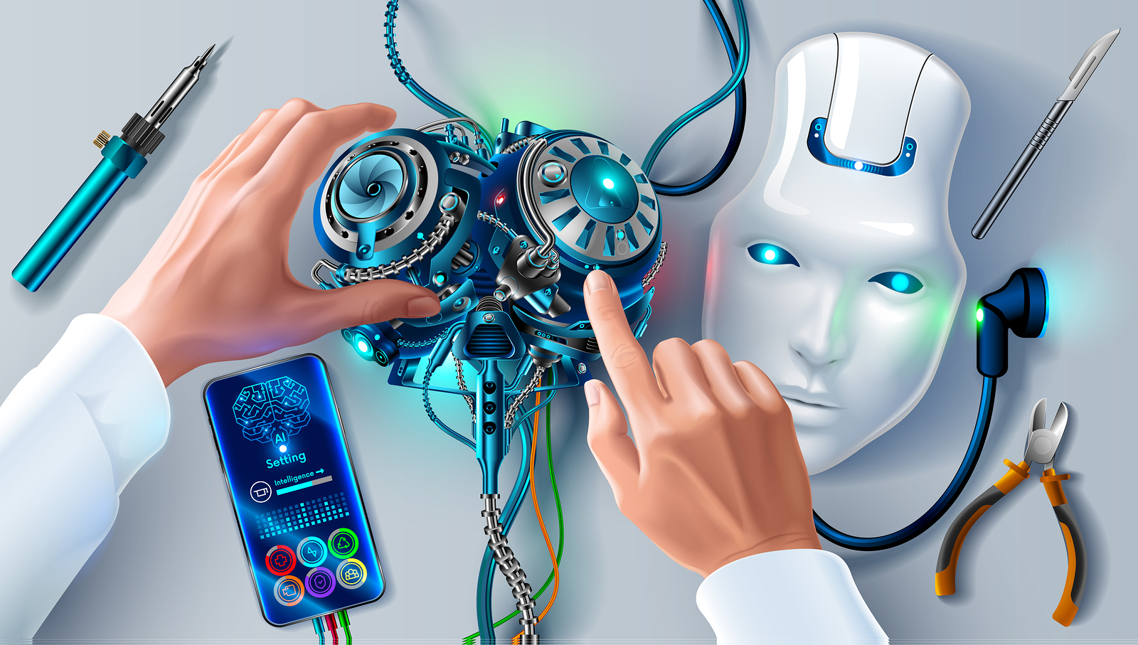
Real-time IoT products

Slide 57
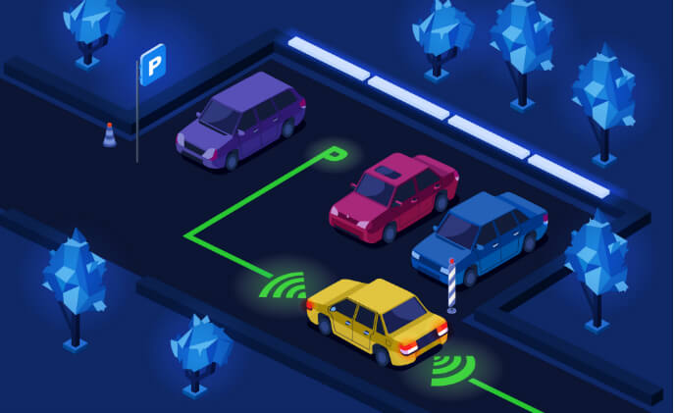
Smart Parking System

Slide 58
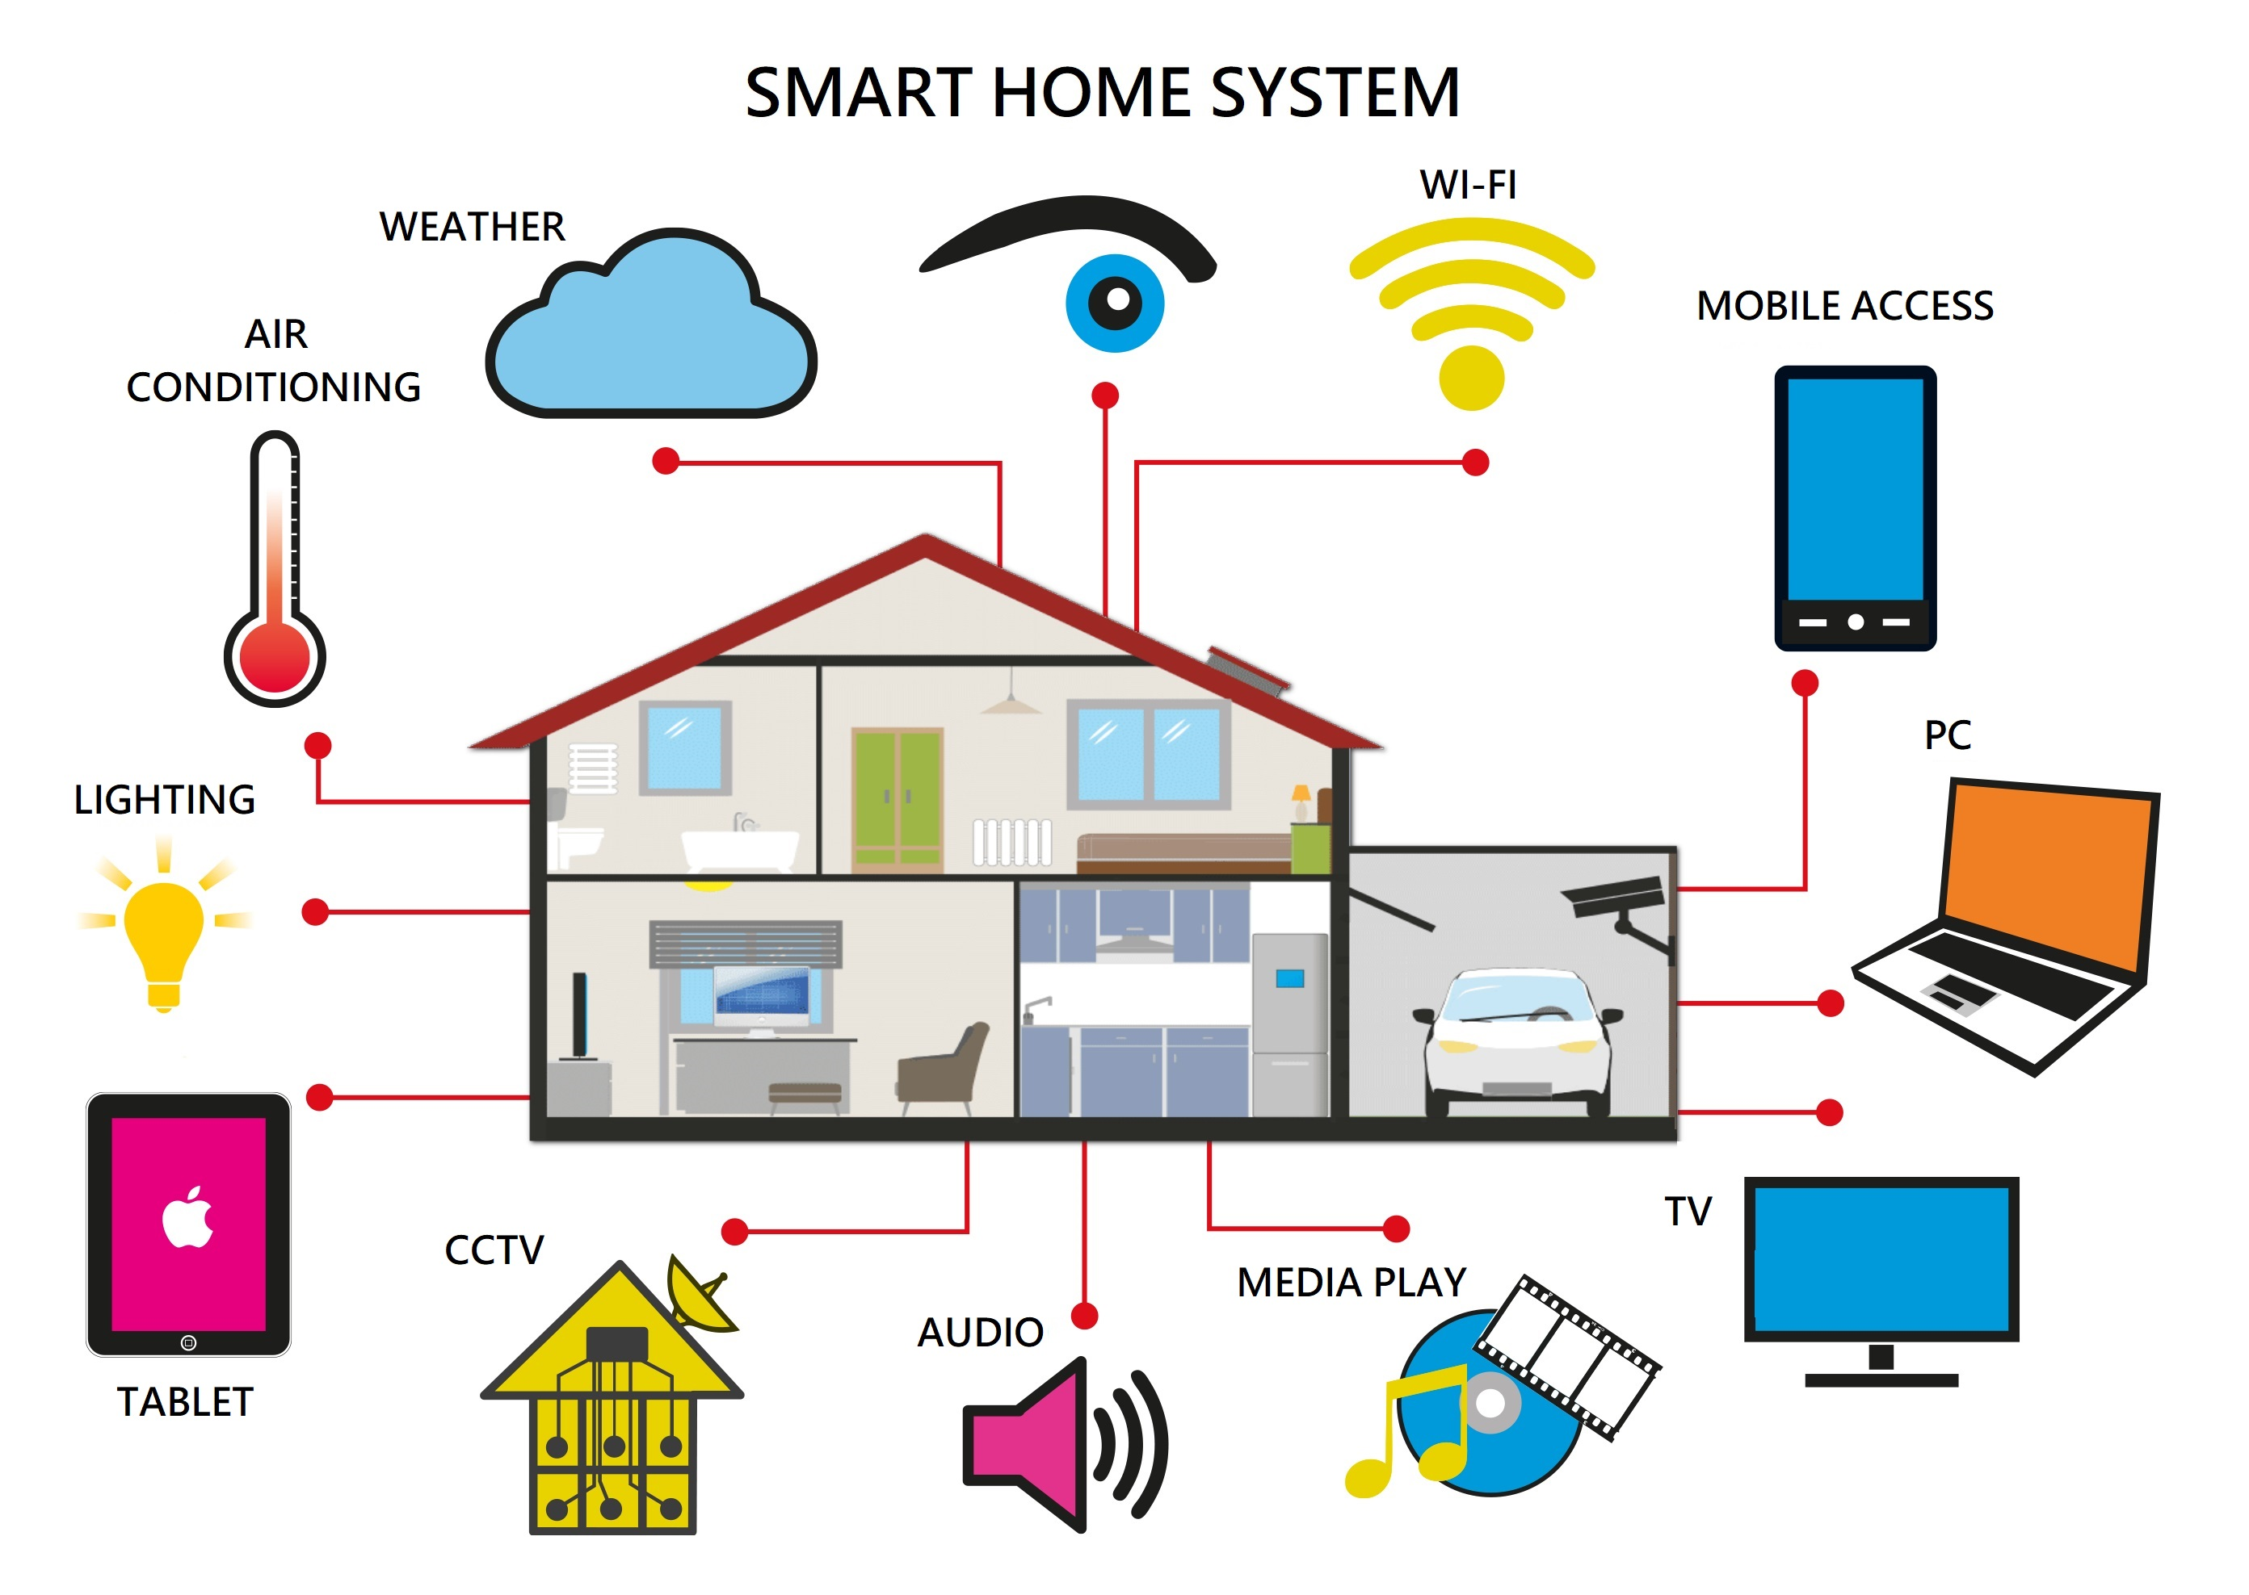
HOME AUTOMATION

Slide 59
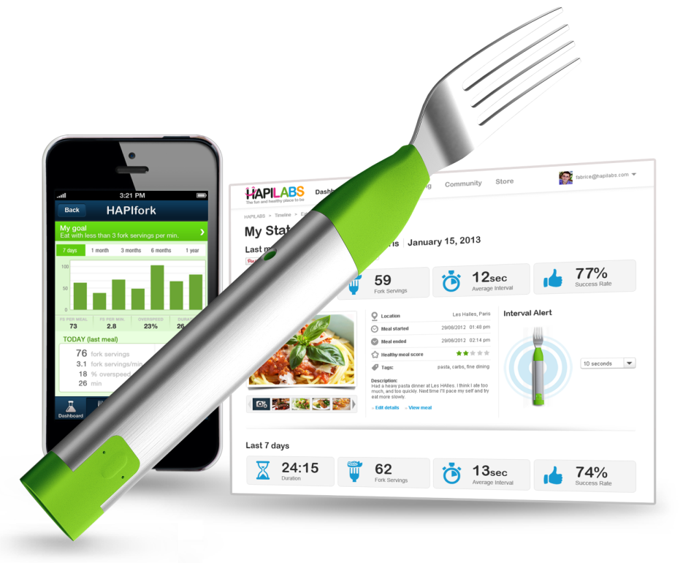
HAPIfork is a smart fork
created by HAPI labs
How long it took to eat your meal.
The amount of "fork servings"
taken per minute.
Intervals between "fork servings".

Slide 60
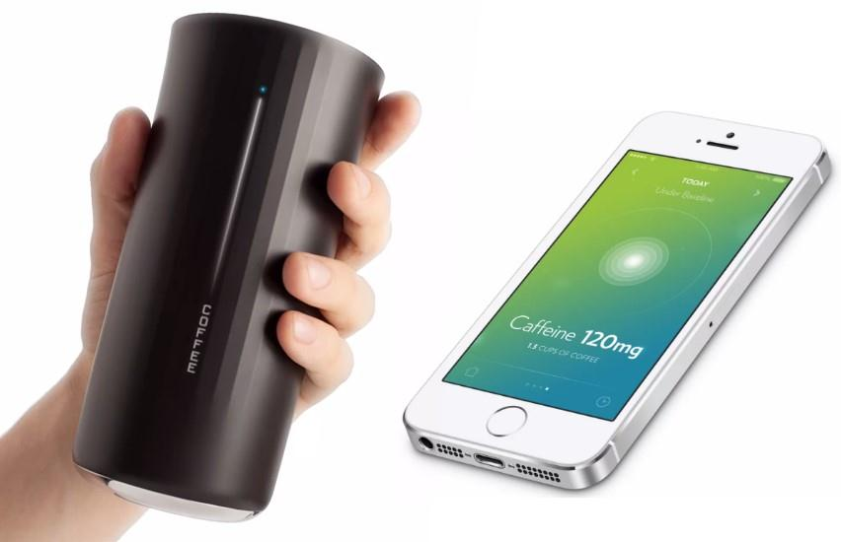
MyVessyl Cup
World first Smart cup
It can measure Sugar, Nutrition, Protein, Calories, Fat
of which is pours Inside the cup.
If we drinking water I calculates, How much liters of waters, we drinking a day.
The cup was to have embedded sensors and the capability of linking to a Smartphone to provide its user with nutritional and other data on the beverage in the cup.

Slide 61
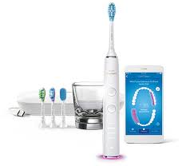
Smart toothbrush
when your toothbrush says you apply too much pressure, barely brushed an area, or aren’t holding your toothbrush at the right angle, you can fix it.
Well, first of all, an electronic toothbrush has already been proven to remove more plaque than a standard manual toothbrush, and toothbrushes with timers have also increased how long people brush their teeth. However, think about how you brush your teeth every day, twice a day.

Slide 62

Smart Egg Tray
It syncs with your smartphone to tell you how many eggs you’ve got at home (up to 14) and when they’re going bad.
Wirelessly connects to your mobile device to track the number of eggs you have and tell you when they’re going bad.
In-tray LED lights indicate the oldest egg, while push notifications alert you when you’re running low.
Check Egg Minder while at the store; you’ll never be in a scramble for a good egg again

Slide 63

Smart Organic farming/ terrace gardening
It aumatically feds water to the plants when water level is low.
Manual monitoring is in practice
which is a very trivial task because the plants may die out if there is
no proper care is taken.
The automatic
monitoring and control of the environmental events such as light
intensity, pH, electrical conductivity, water temperature, and relative
humidity is carried out by lodging sensors and actuators onto the
system

Slide 64

Smart Piggy Bank
Kids could shake the pig and it would tell them how much money was in an online bank account
Legs of the piggy bank will rotate when the coin is inserted
It shows the percentage in neck like loading bar.

Slide 65




Slide 66


Slide 67


Slide 68


Slide 69

The Future is

Slide 70

How It Works??

Slide 71


Slide 72


Slide 73


